Slide 1
DC 9200-9440 Anxiety, Depression, PTSD, MST
By:
Danny Johnson
Notes:
VA uses Diagnostic and Statistical Manual of Mental Disorders or DSM-III

Slide 2
Definition
Anxiety- Anxiety is an emotion characterized by feelings of tension, worried thoughts and physical changes like increased blood pressure. People with anxiety disorders usually have recurring intrusive thoughts or concerns.
Depression-is a mood disorder that causes a persistent feeling of sadness and loss of interest. Also called major depressive disorder or clinical depression, it affects how you feel, think and behave and can lead to a variety of emotional and physical problems. You may have trouble doing normal day-to-day activities, and sometimes you may feel as if life isn't worth living.
Notes:
Just medical words: There a so much more that come to these.

Slide 3
Definition Continued
Post-traumatic stress disorder (PTSD): is a mental health condition that's triggered by a terrifying event — either experiencing it or witnessing it. Symptoms may include flashbacks, nightmares and severe anxiety, as well as uncontrollable thoughts about the event.
Military sexual trauma (MST): refers to sexual assault or sexual harassment experienced during military service. Veterans of all genders and from all types of backgrounds have experienced MST.
Notes:
Just medical words: There a so much more that come to these.

Slide 4
What is needed for the claim
Depression & Anxiety: 526ez and a 4138. Try and get medical records to show.
Don’t need a diagnoses of it but it will help
Writing a 4138 about how they were before service and how they are now.
Buddy statements of military buddies or spouse that show what they are going through.
Even telling them to go to therapy or seeing mental health. Any type of medication.
Stressors that would cause it that are not PTSD
Notes:
Depression and Anxiety: You don’t need a diagnoses of it but it helps. Try and get medical records from private doctors to help with claim. Buddy statements from friends or spouse.
Next we are going to talk about what everyone files for the most. PTSD.

Slide 5
PTSD
Service connection for posttraumatic stress disorder (PTSD) requires
credible evidence that the claimed in-service stressor occurred
medical evidence diagnosing the condition in accordance with 38 CFR 4.125
a link, established by medical evidence, between current symptoms and an in-service stressor.
Will need to fill out a 0781 about the stressor.
Notes:
From the M21-1 what is required for PTSD. You do not need to be diagnose with PTSD to file for PTSD. Medical evidence can be your C&P exam. There are times that 0781 are not required. These are the requiredments.

Slide 6
When 0781 is not required
When a Veteran has received any of the combat decorations listed below, VA will presume that the Veteran engaged in combat with the enemy, unless there is clear and convincing evidence to the contrary:
Air Force Achievement Medal with “V” Device
Air Force Combat Action Medal
Air Force Commendation Medal with “V” Device
Air Force Cross
Air Medal with “V” Device
Army Commendation Medal with “V” Device
Bronze Star Medal with “V” Device
Combat Action Badge
Combat Action Ribbon (Note: Prior to February 1969, the Navy Achievement Medal with “V” Device was awarded.)
Combat Aircrew Insignia
Combat Infantry/Infantryman Badge
Combat Medical Badge
Distinguished Flying Cross
Distinguished Service Cross
Joint Service Commendation Medal with “V” Device
Medal of Honor
Navy Commendation Medal with “V” Device
Navy Cross
Purple Heart
Silver Star.
Notes:
• If a Veteran received a Global War on Terrorism Expeditionary Medal, Global War on Terrorism Service Medal, Afghanistan Campaign Medal, or Iraq Campaign Medal, but not one of the combat decorations cited above, develop for the claimed stressor as shown in M21-1MR, Part IV, Subpart ii, 1.D.14. Receipt of these campaign medals alone does not generally indicate engagement in combat. With these, there is no need to fill out the stressor form. However, there are other ways that veterans can get PTSD while in the military.

Slide 7
When 0781 is required
PTSD may result from a non-combat stressor, such as:
a plane crash
a ship sinking
an explosion
a rape or assault (Which is a different form)
duty in a burn ward, medical unit, or graves registration unit
witnessing the death, injury, or threat to the physical being of another person not caused by the enemy and actual or threatened death or serious injury, or other threat to one’s own physical being not caused by the enemy

Slide 8
What should a good statement include?
Facts of what happened. Who, what, where, when
Best practice is to include the verbiage, “I was in fear for my life.”
Report of mental health before incident
Report of mental health after incident
If diagnosed: date and diagnosis
If not diagnosed: report of symptoms
Keep in mind that a diagnosis is not required, it is often very helpful. Every attempt should be made to get a diagnosis, but if one cannot be obtained, then the claim can be filed without it.

Slide 9
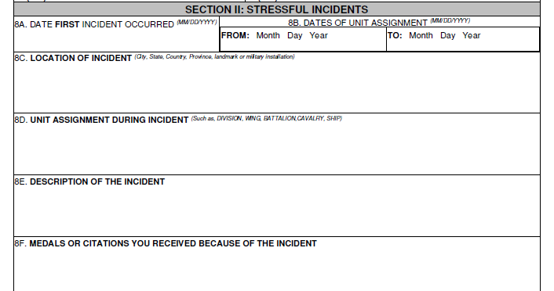
Notes:
At a minimum, the Veteran must provide the following:
a stressor that can be documented
the location where the incident took place
the approximate date (within a two-month period) of the incident, and
the unit of assignment at the time the stressful event occurred.

Slide 10
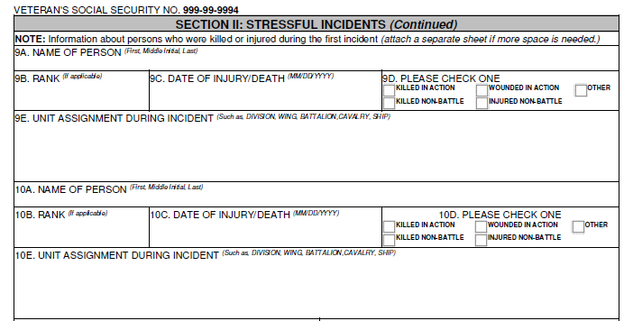
Notes:
These will help the VA find the veteran that got injured.

Slide 11
Where the VA gets their information on Stressors
Primary evidence, generally considered the most reliable source for verifying in-service stressors, is typically obtained from the:
U.S. Army and Joint Services Records Research Center (JSRRC) (formerly the U.S. Armed Services Center for Unit Records Research (CURR))
National Archives and Records Administration (NARA)
Marine Corps Archives and Special Collections (MCASC)
Compensation and Pension (C&P) Service website links.
Notes:
The VA will use the information on the 0781 that you and the veteran filled out and they will use one of these to try and find the information on the veteran. You can also see if the veteran as any news clippings or anything that they could use to show they were there or who got injury.

Slide 12
a. When to Request Corroboration of an In-Service Stressor | Submit a request for corroboration of an in-service stressor if the evidence does not corroborate the Veteran’s claim that he/she engaged in combat or experienced other in-service stressor(s) the in-service stressor claimed is capable of being documented the Veteran’s records contain evidence of a diagnosis of PTSD, such as outpatient treatment records showing treatment for PTSD, or competent lay evidence of persistent or recurrent symptoms of PTSD, such as the Veteran’s description of symptoms indicative of PTSD, and development is complete in every respect except for corroboration of the in-service stressor, and a confirmed diagnosis of PTSD. Important: Do not schedule a VA examination before receiving corroboration of the claimed in-service stressor. A diagnosis of PTSD is not a prerequisite for initiating the stressor verification process. Some stressors are clearly impossible to document and should not be referred to the U.S. Army and Joint Services Records Research Center (JSRRC) (formerly the U.S. Armed Services Center for Unit Records Research (CURR)), NARA, or the Marine Corps. If, after requesting/obtaining pertinent facts from the Veteran, it is obvious that corroboration simply is not feasible, the claim should be decided based on the evidence of record. References: For information on where to send a request for corroboration of an in-service stressor, see M21-1MR, Part IV, Subpart ii, 1.D.15.b, and the types of stressors that may be impossible to corroborate, see the JSRRC Stressor Verification Guide, Section V.

Slide 13
PTSD Secondary to Personal Assault
Personal trauma is an event of human design that threatens or inflicts harm. Veterans claiming service connection for disability due to in-service personal trauma face unique problems documenting their claims.
These incidents are often violent and may lead to the development of PTSD.
Examples: Rape, physical assault, domestic battering, robbery, mugging, stalking, and harassment.
Because personal trauma is an extremely personal and sensitive issue many incidents of personal trauma are not officially reported, and the victims of this type of in-service trauma may find it difficult to produce evidence to support the occurrence of the stressor.
It is often necessary to seek alternative evidence.
To establish service connection for PTSD, there must be credible evidence to support the Veteran’s assertion that the stressful event occurred.
This does not mean that the evidence actually proves that the incident occurred, but that there is at least an approximate balance of positive and negative evidence that the event did occur.*
Notes:
A lot that we see here are MST. I have seen one personal assault and he got 30% for that. What that statement means is there are different ways to see how person have changed. We will see that on the next few slides.

Slide 14
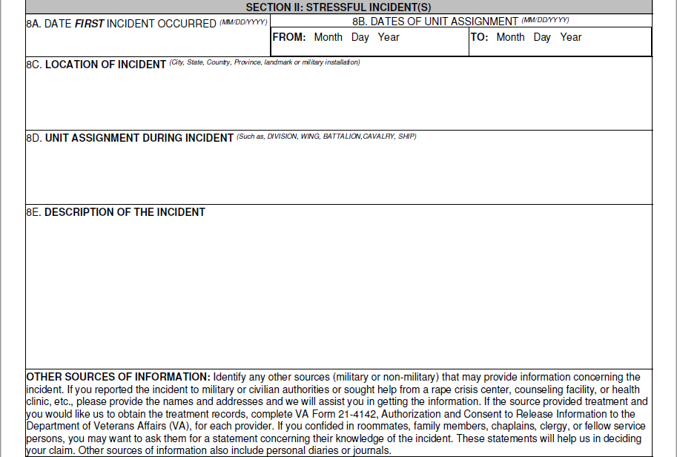
Notes:
After this is name and address that they can use if they want.

Slide 15
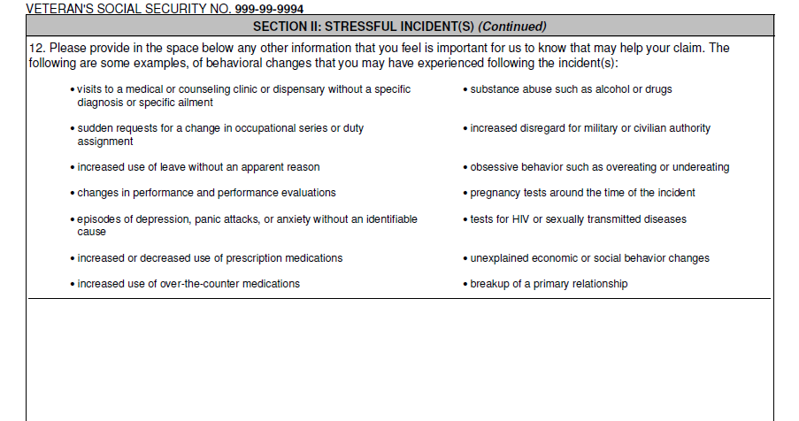
Notes:
This is the part that will help. Were they awol? These statements are the ones that will help with showing there was some incident.

Slide 16
Mental Health Not Service Connectable*
Attention-Deficit/Hyperactivity Disorder (also referred to as Attention Deficit Disorder)
Autism Spectrum Disorder
Specified Learning Disorder
Tic Disorder
Stuttering
Intellectual Disability (Intellectual Developmental Disorder)
Neurodevelopmental disorders are not considered diseases or injuries under 38 CFR 3.303(c). Since they are not diseases or injuries, they are not generally subject to direct SC.*
Notes:
Unless due to TBI or a secondary for neurodevelopmental: autism, learning disabilities, intellectual disability (also known as mental retardation), conduct disorders, cerebral palsy, and impairments in vision and hearing, stutter.
After all this, we will send it up and then it is up at the VA to looking through and try and verified that all conditions are met. PTSD is seeing the stresses.

Slide 17

Appointment
Childhood/pre-military traumas
Childhood/pre-military family and peer relationships/social functioning
Social/marital issues during military service
Veteran's current psychosocial and marital functioning
Occupational History PRIOR, During, and After Service
Educational History PRIOR, During, and After Service
Notes:
When they finally get to an exam. I always tell the veterans that this is not an appointment to get help. They are evaluating you and they are going to have to ask you questions about everything in your life. They are doing this to help show that the military was the caused of the issues. Above is what I took from a C&P exam that they will ask veterans. Just to give you an ideas.

Slide 18
Appointment
Relevant Mental Health history, to include prescribed medications and family mental health (pre-military, military, and post-military)
Family of origin mental health issues, including alcoholism/addiction, psychiatric diagnoses/hospitalizations
Veteran's mental health issues during military service
Veteran's current mental health problems, treatment, medications, hospitalizations, suicide attempts
Relevant Legal and Behavioral history (pre-military, military, and post-military)
Legal issues during military service
Post-military/current legal issues, problems with violence
Substance/Alcohol Abuse before, during, and after
Notes:
After this, they will send it to an RO. PTSD can be seen at all RO. Always tell the veterans that they take longer due to this is not as easy as a hurt shoulder. They need to look at everything. However, MST is looked at a different location.

Slide 19
Regional Offices Reviewing MST (2022) :
306 - New York Regional Office: MST Care Processing Site
308 - Hartford Regional Office: MST Care Processing Site
319 - Columbia Regional Office: MST Care Processing Site
320 - Nashville Regional Office: MST Care Processing Site
326 - Indianapolis Regional Office: MST Care Processing Site
334 - Lincoln Regional Office: MST Care Processing Site
348 - Portland Regional Office: MST Care Processing Site
351 - Muskogee Regional Office: MST Care Processing Site) due to specific routing rules.
Notes:
These are the RO that help with MST. Do with this as you use.

Slide 20
General Rating Formula for Mental Disorders
 | Rating
Total occupational and social impairment, due to such symptoms as: gross impairment in thought processes or communication; persistent delusions or hallucinations; grossly inappropriate behavior; persistent danger of hurting self or others; intermittent inability to perform activities of daily living (including maintenance of minimal personal hygiene); disorientation to time or place; memory loss for names of close relatives, own occupation, or own name. | 100
Occupational and social impairment, with deficiencies in most areas, such as work, school, family relations, judgment, thinking, or mood, due to such symptoms as: suicidal ideation; obsessional rituals which interfere with routine activities; speech intermittently illogical, obscure, or irrelevant; near-continuous panic or depression affecting the ability to function independently, appropriately and effectively; impaired impulse control (such as unprovoked irritability with periods of violence); spatial disorientation; neglect of personal appearance and hygiene; difficulty in adapting to stressful circumstances (including work or a worklike setting); inability to establish and maintain effective relationships. | 70
Occupational and social impairment with reduced reliability and productivity due to such symptoms as: flattened affect; circumstantial, circumlocutory, or stereotyped speech; panic attacks more than once a week; difficulty in understanding complex commands; impairment of short- and long-term memory (e.g., retention of only highly learned material, forgetting to complete tasks); impaired judgment; impaired abstract thinking; disturbances of motivation and mood; difficulty in establishing and maintaining effective work and social relationships. | 50
Occupational and social impairment with occasional decrease in work efficiency and intermittent periods of inability to perform occupational tasks (although generally functioning satisfactorily, with routine behavior, self-care, and conversation normal), due to such symptoms as: depressed mood, anxiety, suspiciousness, panic attacks (weekly or less often), chronic sleep impairment, mild memory loss (such as forgetting names, directions, recent events). | 30
Occupational and social impairment due to mild or transient symptoms which decrease work efficiency and ability to perform occupational tasks only during periods of significant stress, or symptoms controlled by continuous medication. | 10
A mental condition has been formally diagnosed, but symptoms are not severe enough either to interfere with occupational and social functioning or to require continuous medication. | 0

Slide 21
Future exams
Future mental health exams are only required or allowed under certain circumstances:
When assigning a pre-stabilization rating
When the evidence of record clearly shows the likelihood for improvement
Sound medical evidence is required, indicating the likelihood of improvement, to warrant a future exam. Other than those reasons listed above, there are no automatic future exams required or allowed by regulations.
Notes:
See this a lot in veterans that just got out and applied for it. With depression and Anxiety.

Slide 22
Secondary's
Sometimes Mental Health issues have secondaries.
Sometimes Mental Health is the secondary.
Notes:
This is a pretty tricky part. There is a lot of Secondary's that can come with this.

Slide 23
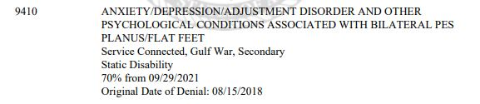
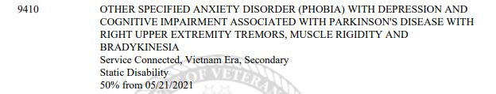



Slide 24


Slide 25
Challenges
Mental State
Homelessness

Slide 26

Some ways to help
We are not doctors. Lend a listening hear but send them to experts if you think they need it
Support them
If claim is for MST, ask if they want to write the statement at home and email or if they want to see a Female VSO
Don’t judge their situation
Not up to use to decide if they have it
Give them advise on how to file for condition
Notes:
( If they really just have wide range of stories in the military, maybe try for depression?) Look at DD214 for any awards or anything. If they were secondary or not to incidents.

Slide 27
References:
https://pubmed.ncbi.nlm.nih.gov/34283458/
https://www.mentalhealth.va.gov/docs/mst_general_factsheet.pdf
https://pubmed.ncbi.nlm.nih.gov/3787052/
https://www.ecfr.gov/current/title-38/chapter-I/part-4
§ 4.130 Schedule of ratings - Mental disorders.

